Slide 1
Fundamental Concepts
Abstraction—data, procedure, control
Architecture—the overall structure of the software
Patterns—”conveys the essence” of a proven design solution
Separation of concerns—any complex problem can be more easily handled if it is subdivided into pieces
Modularity—compartmentalization of data and function
Information Hiding—controlled interfaces
Functional independence—single-minded function and low coupling
Refinement—elaboration of detail for all abstractions
Aspects—a mechanism for understanding how global requirements affect design
Refactoring—a reorganization technique that simplifies the design
OO design concepts—Appendix II
Design Classes—provide design detail that will enable analysis classes to be implemented

Slide 2
Separation of Concerns
Separation of Concerns is a design concept that suggests that any complex problem can be more easily handled if it is subdivided into pieces that can each be solved and/or optimized independently.
A concern is a feature or behavior that is specified as part of the requirements model for the software.
By separating concerns into smaller, and therefore more manageable pieces, a problem takes less effort and time to solve.

Slide 3
Modularity
Software is divided into separately named and addressable components called modules.
We modularize a design so that development can be more easily planned; software increments can be defined and delivered; changes can be more easily accommodated and debugging can be conducted more efficiently.

Slide 4
Modularity: Trade-offs
What is the "right" number of modules
for a specific software design?
module development cost
cost of
software
module
integration
cost
optimal number
number of modules
of modules

Slide 5
Information Hiding
The intent of Information Hiding is to hide the details of data structures and procedural processing behind a module interface. Knowledge of the details need not be known by users of the module.
Modules should be specified and designed so that information (algorithms and data) contained within a module is inaccessible to other modules that have no need for such information.

Slide 6
Information Hiding
module
• algorithm
controlled
interface
• data structure
• details of external interface
• resource allocation policy
clients
"secret"
a specific design decision

Slide 7
Why Information Hiding?
Modularity leads to access of information to particular entities.
Information hiding is used to enforce the access constraints to a local details as well as the data structures used.
emphasizes communication through controlled interfaces
discourages the use of global data
leads to encapsulation—an attribute of high quality design
results in higher quality software
Modules are the ones that are not dependent and they don’t want their data to get shared

Slide 8
Functional Independence
Functional Independence is achieved by developing modules with “single minded” function and an “aversion” to excessive interaction with other modules.
Cohesion: It is an indication of the relative functional strength of a module (a qualitative indication of the degree to which a module focuses on just one thing).
Coupling: It is an indication of the relative interdependence among modules.
If good design is to be achieved, one should strive for high cohesion and low coupling.

Slide 9
Refinement
Abstraction and refinement are complimentary concepts
Refinement is a process of elaboration
Refine the requirement by decomposing it
until it reaches to the state where it clearly elaborates the system.
Abstraction shows the procedures and data whereas the refinement shows the implementation and low level details

Slide 10
Stepwise Refinement
open
walk to door;
reach for knob;
open door;
repeat until door opens
turn knob clockwise;
walk through;
if knob doesn't turn, then
close door.
take key out;
find correct key;
insert in lock;
endif
pull/push door
move out of way;
end repeat

Slide 11
Architecture
Shows the overall structure of the software and the way in which the Structure provides conceptual integrity for a system.
Architecture design = structure of data + program components needed for system
Just a blue print of overall system, not an operational component
Shows dataflow, control flow, dependencies.
Conceptual integrity is the property of a system to work on a consistent set of concepts, such as entities (user, groups, posts) or operations (transfer money to an account or convert it in different currencies). If a railway system has three different websites for selling tickets (I know of at least one case), each with different functionalities, its overall system lacks conceptual integrity.
Architectural design can be represented using following models:
Structural models ->show arch as organized collection of components
Framework models ->more abstract design , hiding the repeatable components
Dynamic models -> show how program structure may changed because of an external event
Process models ->focus on functional requirements related to business process design and implementation
Functional models -> represent system functionality hierarchy wrt. dependence

Slide 12
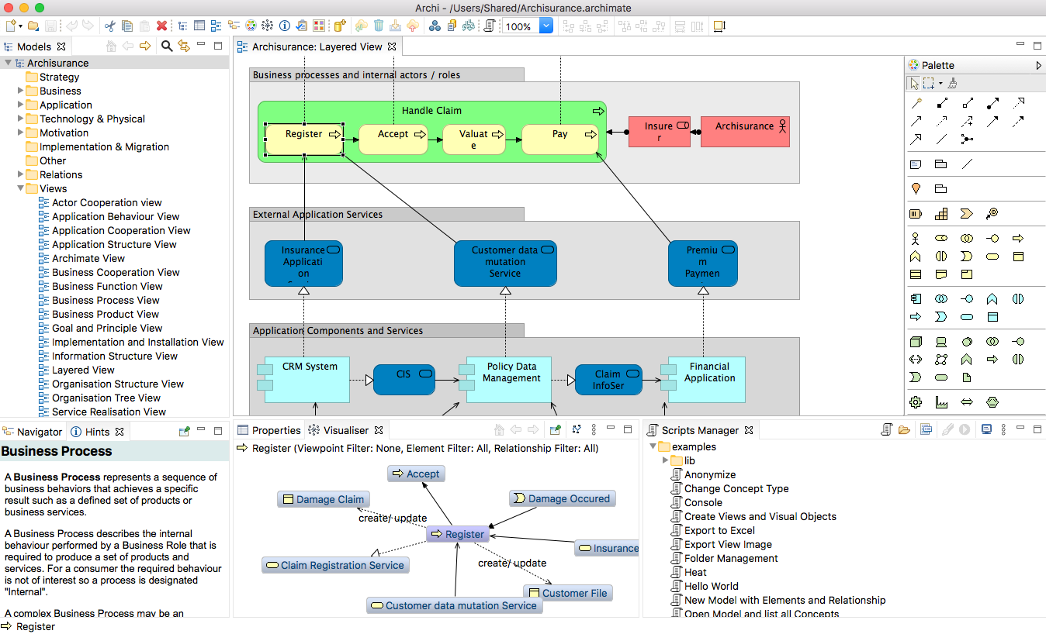
Architecture Design developed using ArchiMate tool

Slide 13
Refactoring
Simplifies the design of a component without changing its behavior by eliminating redundant codes and designs that might lead to system failures.
So improves the internal structure of the system without disturbing the external behavior of the code
When software is refactored, the existing design is examined for
redundancy
unused design elements
inefficient or unnecessary algorithms
poorly constructed or inappropriate data structures
or any other design failure that can be corrected to yield a better design.

Slide 14
Aspects
Consider two requirements, A and B. Requirement A crosscuts requirement B “if a software decomposition [refinement] has been chosen in which B cannot be satisfied without taking A into account. [Ros04]
An aspect is a representation of a cross-cutting concern.

Slide 15
Aspects—An Example
Consider two requirements for the SafeHomeAssured.com WebApp.
Requirement A is described via the use-case Access camera surveillance via the Internet. A design refinement would focus on those modules that would enable a registered user to access video from cameras placed throughout a space.
Requirement B is a generic security requirement that states that a registered user must be validated prior to using SafeHomeAssured.com. This requirement is applicable for all functions that are available to registered SafeHome users.
As design refinement occurs, A* is a design representation for requirement A and B* is a design representation for requirement B. Therefore, A* and B* are representations of concerns, and B* cross-cuts A*.
An aspect is a representation of a cross-cutting concern. Therefore, the design representation, B*, of the requirement, a registered user must be validated prior to using SafeHomeAssured.com, is an aspect of the SafeHome WebApp.

Slide 16
OO Design Concepts
Design classes
Design classes by providing the detail needed to implement the classes and implement a software infrastructure that support the business solution.
Inheritance—all responsibilities of a superclass is immediately inherited by all subclasses
Polymorphism—a characteristic that greatly reduces the effort required to extend the design

Slide 17
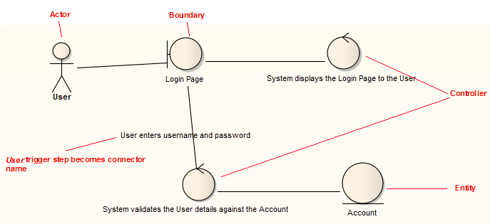
OO Design Concepts

Slide 18
Design Model Elements
Data elements
Data model --> data structures
Data model --> database architecture
Architectural elements
Application domain
Analysis classes, their relationships, collaborations and behaviors are transformed into design realizations
Patterns and “styles”
Interface elements
the user interface (UI)
external interfaces to other systems, devices, networks or other producers or consumers of information
internal interfaces between various design components.
Component elements
Deployment elements

Slide 19
Data Design Elements
Creates a model of data represented at a higher level of abstraction
Users/customers’ view of data
After that refined to more implementation-specific representation that can be processed by the system
Data architecture has an impact on software architecture (as an effective design may lead to efficient processing)
Data elements are important because the translation of data model to the database at the application level is an integral part of the design
Moreover, efficient data storage may result in a data warehousing
That may lead to data mining or knowledge discovery via insights’ extraction which has an impact on business success

Slide 20
Architectural Design Elements
As a house floor plan contains all the details, likewise the architectural design shows the overall view of the software system.
Architectural model is derived from:
Information about the application domain for which the software is being built
Requirement elements like dataflow diagrams, relationship or collaboration diagrams
The availability of architectural styles (e.g., data-centered arch. , OO arch, layered architectures)
Usually depicted as a set of interconnected subsystems
Which are derived from work packages of the requirements
Each subsystem may have its own architecture design

Slide 21
Interface Elements
As detailed drawings show the inner view of the plan
likewise, the interface elements show the information flows into and out of the system. And how that information is communicated among system modules.
3 important elements of interface design are:
UI design (for managers)
External interface to other devices/components/consumers
Internal interfaces between various components (different screens in a module)
Tools like adobe Xd, Figma, etc. could be used
It encompasses:
the aesthetic elements(layout , color scheme, visuals)
Ergonomic elements (UI navigation, information placement)

Slide 22
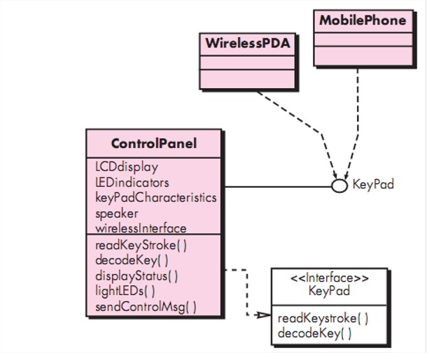
Interface Elements
External interface design must incorporate input validation and security.
Interfaces could be modeled as the external visualizers of public operations of class without showing the internal implementation details.

Slide 23
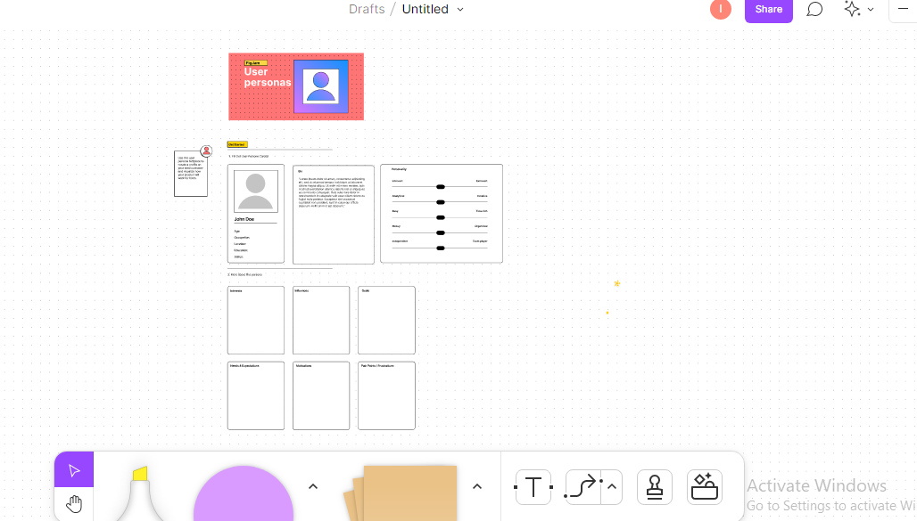
Interface Elements

Slide 24
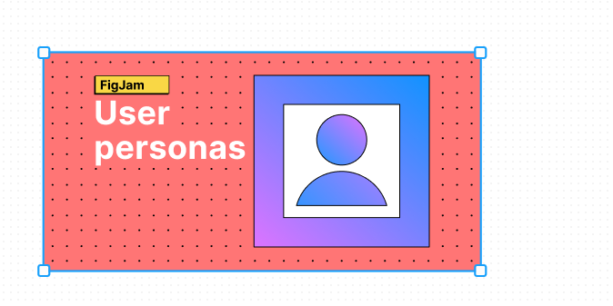
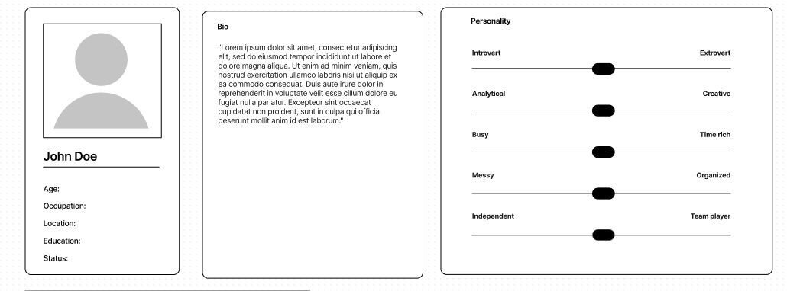
Interface Elements

Slide 25
Component Elements
In software design component, design is equivalent to a set of detailed drawings for a room.
Describes internal details of a software component
It defines :
Data structures for all local data objects (depends on nature of the object)
Algorithmic details of the process occurs in a component (shown using activity diag. / flowcharts/pseudocode)
Interface which allows access to all component operations

Slide 26
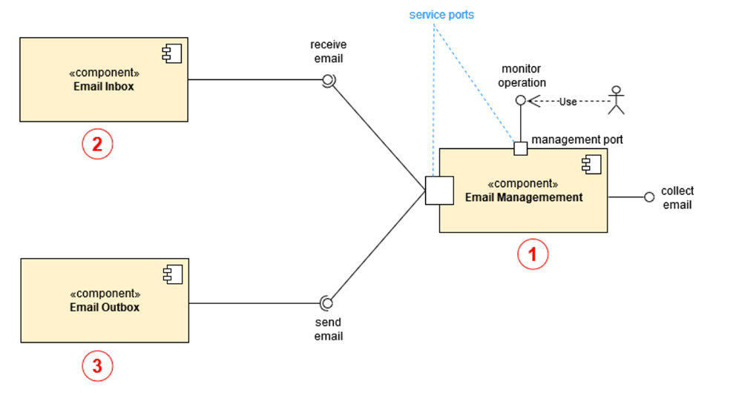

Component Elements
External interface
Assembly connectors

Slide 27
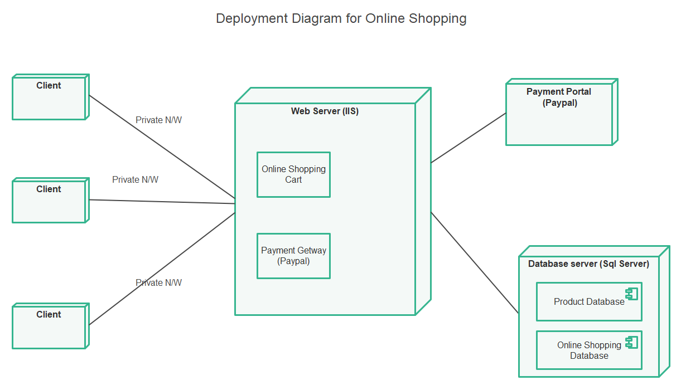
Deployment Elements
Shows what are the physical computing environment in which the software functionality and the subsystems operate.

